Slide 1

Academic Session 2026-27
ODD Semester July-Dec 2026
UNIVERSITY INSTITUTE OF ENGINEERING AND TECHNOLOGY
Department of TT
Bachelor of Engineering (B.E.) – CSE
Advanced Data Structures / Semester 3
(CS221)
Unit No. 1 Chapter No. 1.1 Lecture No. 5
Topic : Insertion & Deletion in Arrays
Abhishek Thakur (E19789) Technical Trainer
Sourav Jaiswal (E19756)-MSC Technical Trainer

Slide 2
Learning Objectives
Write the algorithm for inserting an element at any position in an array.
Write the algorithm for deleting an element from any position in an array.
Analyse the time complexity of both insertion and deletion operations.
Identify when arrays are unsuitable and linked lists are preferred.

Slide 3
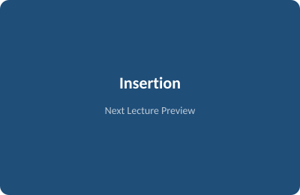
Insertion in an Array
Problem: Insert element X at position POS in array A of current size N.
Precondition: Array must have capacity >= N+1 to hold the new element.
Algorithm: INSERT(A,N,POS,X): k=N; while k>=POS: A[k+1]=A[k], k--; A[POS]=X; N++
Best case: O(1) — inserting at the end (no shifting needed).
Worst case: O(n) — inserting at index 0 (all N elements must shift right).

Slide 4
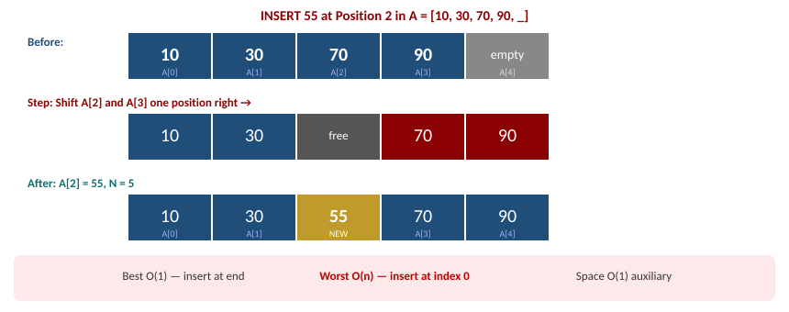
Insertion – Step-by-Step Visual

Slide 5
Deletion in an Array
Problem: Delete element at position POS from array A of size N.
Algorithm: DELETE(A,N,POS): X=A[POS]; k=POS; while k<N-1: A[k]=A[k+1], k++; N--; return X
Best case: O(1) — deleting from the end (no shifting needed).
Worst case: O(n) — deleting from index 0 (all remaining elements shift left).
Limitation: Frequent mid-array deletions make arrays inefficient; prefer Linked Lists.

Slide 6
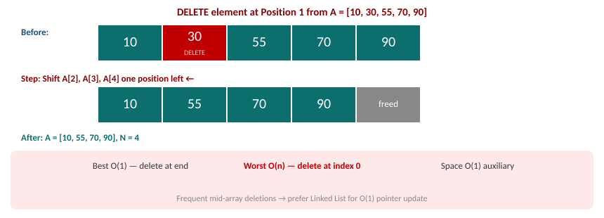
Deletion – Step-by-Step Visual

Slide 7
Summary of the Lecture
Insertion at POS shifts elements right; worst case O(n) when inserting at index 0.
Deletion at POS shifts elements left; worst case O(n) when deleting from index 0.
Both operations are O(1) when performed at the end of the array.
Array must be pre-sized with sufficient capacity before insertion.
Frequent mid-array insertions/deletions -> prefer Linked Lists (O(1) pointer update).

Slide 8

Next Lecture
Searching – Linear Search algorithm and complexity analysis.

Slide 9
Quiz/ FAQ's
Q1. Insert 25 at position 2 in A=[5,10,20,30,40]. Show each step of the algorithm.
Q2. What is the worst-case time complexity of array deletion? When does it occur?
Q3. Why are arrays unsuitable for applications with frequent mid-array insertions?

Slide 10
References/ Articles
Seymour Lipschutz, Data Structures, Schaum's Outlines, McGraw-Hill.
GeeksforGeeks – Array Insertion: https://www.geeksforgeeks.org/array-data-structure/
Visualgo – Array Visualiser: https://visualgo.net/en/array

Slide 11
Thank You
For queries
Email: abhishek.e19789@cumail.in

